Slide 1

Handwritten Digit Recognition
Presented by Group-4

Slide 2
Problem
Handwritten digit recognition is a fundamental task in computer vision. The goal is to classify images of handwritten digits (0 to 9) correctly.
Infosys Springboard

Slide 3
Problem
Applications include postal code recognition, check digit verification, and digit-based CAPTCHAs.
Handwritten digit recognition is a fundamental task in computer vision. The goal is to classify images of handwritten digits (0 to 9) correctly.
Infosys Springboard

Slide 4
Problem
Applications include postal code recognition, check digit verification, and digit-based CAPTCHAs.
Handwritten digit recognition is a fundamental task in computer vision. The goal is to classify images of handwritten digits (0 to 9) correctly.
We’ll be using the MNIST dataset, which contains 28x28 grayscale images of handwritten digits.
Infosys Springboard

Slide 5
Investigation
Approach
Models Used
Objective
Train each model on a standard dataset of handwritten digits.
Evaluate and compare their accuracy, training time, and computational efficiency.
Multilayer Perceptron (MLP): A simple neural network with fully connected layers.
Convolutional Neural Network (CNN): A deep learning model specifically designed for image data.
LeNet-5: A pioneering CNN architecture designed by Yann LeCun for digit recognition.
To compare the performance of different neural network models (MLP, CNN, and LeNet-5) for handwritten digit recognition.
Infosys Springboard

Slide 6
Investigation
Approach
Models Used
Objective
Train each model on a standard dataset of handwritten digits.
Evaluate and compare their accuracy, training time, and computational efficiency.
Multilayer Perceptron (MLP): A simple neural network with fully connected layers.
Convolutional Neural Network (CNN): A deep learning model specifically designed for image data.
LeNet-5: A pioneering CNN architecture designed by Yann LeCun for digit recognition.
To compare the performance of different neural network models (MLP, CNN, and LeNet-5) for handwritten digit recognition.

Slide 7
Investigation
Approach
Models Used
Objective
Train each model on a standard dataset of handwritten digits.
Evaluate and compare their accuracy, training time, and computational efficiency.
Multilayer Perceptron (MLP): A simple neural network with fully connected layers.
Convolutional Neural Network (CNN): A deep learning model specifically designed for image data.
LeNet-5: A pioneering CNN architecture designed by Yann LeCun for digit recognition.
To compare the performance of different neural network models (MLP, CNN, and LeNet-5) for handwritten digit recognition.

Slide 8




MNIST Dataset
Infosys Springboard

Slide 9
MNIST Dataset
Overview
Contains 60,000 training images and 10,000 testing images.
Each image is a 28x28 pixel grayscale image of a single handwritten digit
Infosys Springboard

Slide 10
MNIST Dataset
Overview
Contains 60,000 training images and 10,000 testing images.
Each image is a 28x28 pixel grayscale image of a single handwritten digit
Preprocessing
Normalization: Scale pixel values to [0, 1] range.
One-hot encoding: Convert labels to one-hot vectors for training.
Infosys Springboard

Slide 11
Model
Architecture
Infosys Springboard

Slide 12
1
3
CNN
MLP
LeNet-5
Input Layer: 28x28 pixels flattened to 784 features.
Hidden Layers:
Layer 1: 64 neurons, BatchNormalization, ReLU, Dropout (0.5).
Layer 2: 32 neurons, BatchNormalization, ReLU, Dropout (0.5).
Output Layer: 10 neurons (one for each digit).

Slide 13
1
2
3
MLP
CNN
Input Layer: 28x28 pixels flattened to 784 features.
Hidden Layers:
Layer 1: 64 neurons, BatchNormalization, ReLU, Dropout (0.5).
Layer 2: 32 neurons, BatchNormalization, ReLU, Dropout (0.5).
Output Layer: 10 neurons (one for each digit).
LeNet-5
Input Layer: 28x28 pixels, 1 channel.
Conv Layers:
Conv1: 32 filters, 3x3 kernel, ReLU, MaxPool (2x2).
Conv2: 64 filters, 3x3 kernel, ReLU, MaxPool (2x2).
Fully Connected Layers:
FC1: 128 neurons, ReLU.
Output: 10 neurons (one for each digit).

Slide 14
1
2
3
MLP
CNN
LeNet-5
Input Layer: 28x28 pixels flattened to 784 features.
Hidden Layers:
Layer 1: 64 neurons, BatchNormalization, ReLU, Dropout (0.5).
Layer 2: 32 neurons, BatchNormalization, ReLU, Dropout (0.5).
Output Layer: 10 neurons (one for each digit).
Input Layer: 28x28 pixels, 1 channel.
Conv Layers:
Conv1: 32 filters, 3x3 kernel, ReLU, MaxPool (2x2).
Conv2: 64 filters, 3x3 kernel, ReLU, MaxPool (2x2).
Fully Connected Layers:
FC1: 128 neurons, ReLU.
Output: 10 neurons (one for each digit).
Input Layer: 28x28 pixels, 1 channel.
Conv Layers:
Conv1: 6 filters, 5x5 kernel, ReLU, MaxPool (2x2).
Conv2: 16 filters, 5x5 kernel, ReLU, MaxPool (2x2).
Fully Connected Layers:
FC1: 120 neurons, ReLU.
FC2: 84 neurons, ReLU.
Output: 10 neurons (one for each digit).

Slide 15
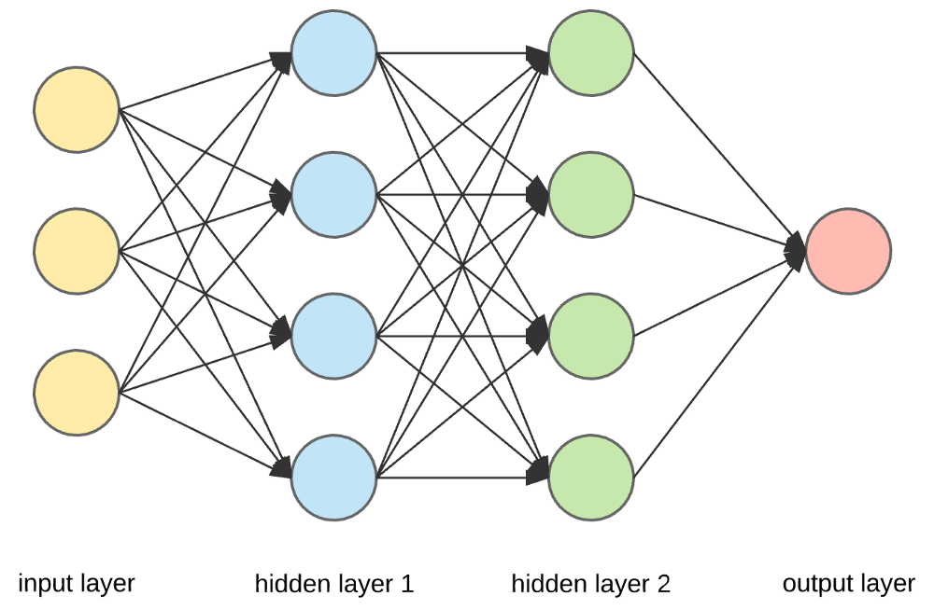

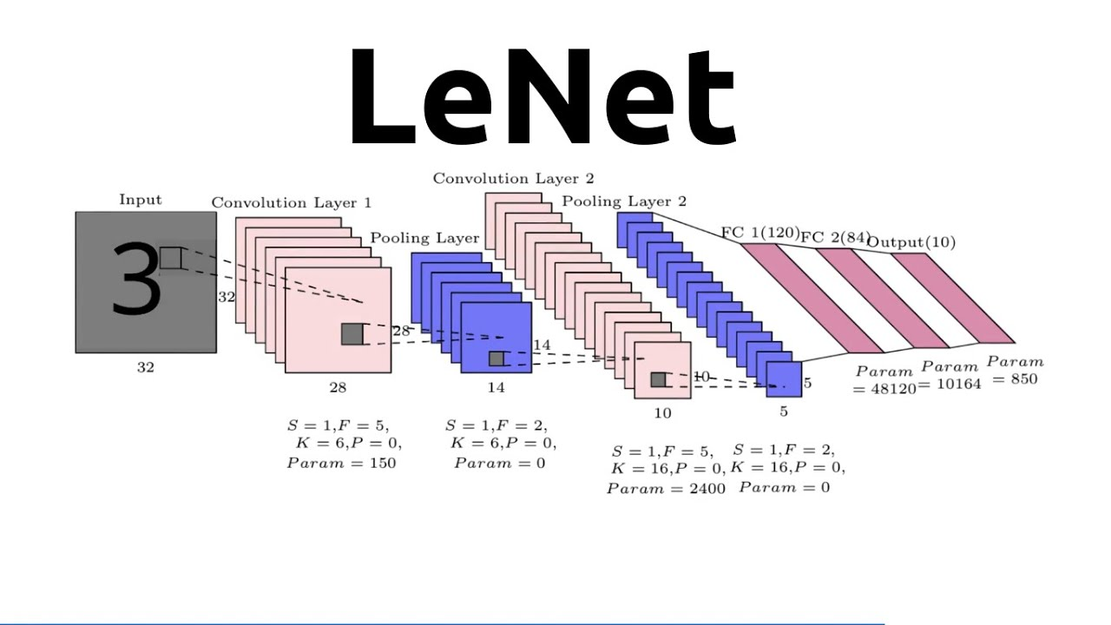
Sample Architecture
Images
1
2
3
Infosys Springboard

Slide 16
1
2
3
Infosys Springboard

Slide 17
1
2
3
Infosys Springboard

Slide 18
1
2
3
Infosys Springboard

Slide 19
Model Training
Training phase
Validation phase
Data Loading: Input images and labels are loaded in batches from the training dataset.
Forward Pass: Images are passed through the model to obtain outputs.
Loss Calculation: The loss between the model's outputs and the actual labels is computed using a specified criterion.
Backward Pass: Gradients are calculated by backpropagating the loss through the network.
Parameter Update: Model parameters are updated using an optimizer.
Accuracy Calculation: Training accuracy is computed as the percentage of correctly predicted labels.
Model Evaluation: The model is evaluated on a validation dataset without updating the model parameters.
Loss Calculation: Validation loss is computed similarly to the training loss.
Accuracy Calculation: Validation accuracy is computed as the percentage of correctly predicted labels on the validation dataset.
Performance Metrics
Training and Validation Accuracy: These metrics are tracked and plotted over the epochs to observe the model's performance.
Training and Validation Loss: Loss values are tracked and plotted to ensure proper convergence and to detect overfitting.
Infosys Springboard

Slide 20
Model Training
Training phase
Validation phase
Data Loading: Input images and labels are loaded in batches from the training dataset.
Forward Pass: Images are passed through the model to obtain outputs.
Loss Calculation: The loss between the model's outputs and the actual labels is computed using a specified criterion.
Backward Pass: Gradients are calculated by backpropagating the loss through the network.
Parameter Update: Model parameters are updated using an optimizer.
Accuracy Calculation: Training accuracy is computed as the percentage of correctly predicted labels.
Model Evaluation: The model is evaluated on a validation dataset without updating the model parameters.
Loss Calculation: Validation loss is computed similarly to the training loss.
Accuracy Calculation: Validation accuracy is computed as the percentage of correctly predicted labels on the validation dataset.
Performance Metrics
Training and Validation Accuracy: These metrics are tracked and plotted over the epochs to observe the model's performance.
Training and Validation Loss: Loss values are tracked and plotted to ensure proper convergence and to detect overfitting.
Infosys Springboard

Slide 21
Model Training
Training phase
Validation phase
Data Loading: Input images and labels are loaded in batches from the training dataset.
Forward Pass: Images are passed through the model to obtain outputs.
Loss Calculation: The loss between the model's outputs and the actual labels is computed using a specified criterion.
Backward Pass: Gradients are calculated by backpropagating the loss through the network.
Parameter Update: Model parameters are updated using an optimizer.
Accuracy Calculation: Training accuracy is computed as the percentage of correctly predicted labels.
Model Evaluation: The model is evaluated on a validation dataset without updating the model parameters.
Loss Calculation: Validation loss is computed similarly to the training loss.
Accuracy Calculation: Validation accuracy is computed as the percentage of correctly predicted labels on the validation dataset.
Performance Metrics
Training and Validation Accuracy: These metrics are tracked and plotted over the epochs to observe the model's performance.
Training and Validation Loss: Loss values are tracked and plotted to ensure proper convergence and to detect overfitting.
Infosys Springboard

Slide 22
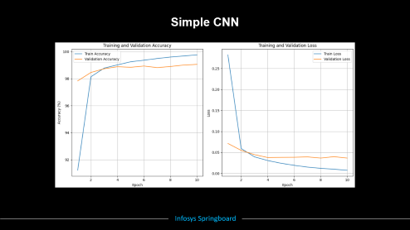
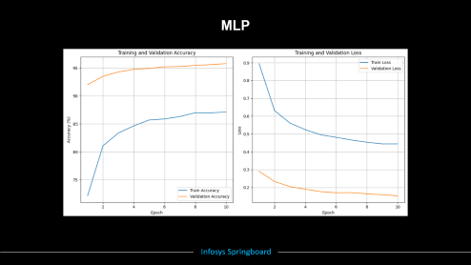
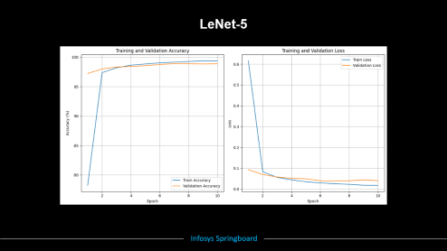
Training and Validation Plots
Infosys Springboard

Slide 23
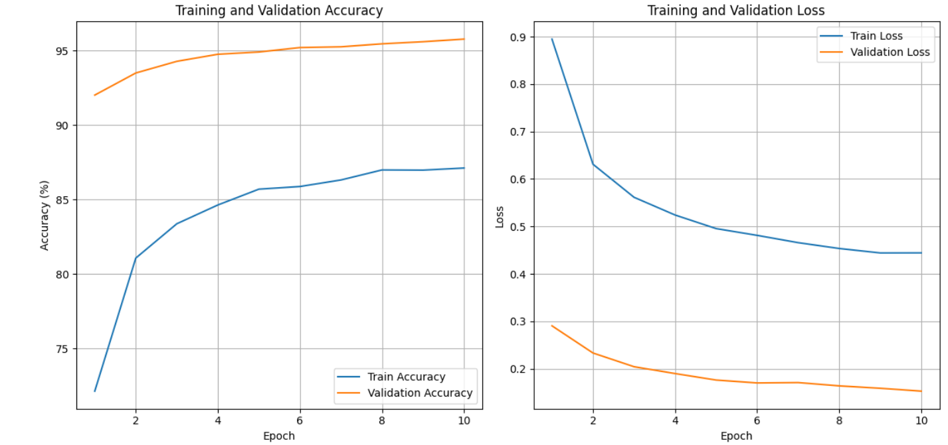
MLP
Infosys Springboard

Slide 24
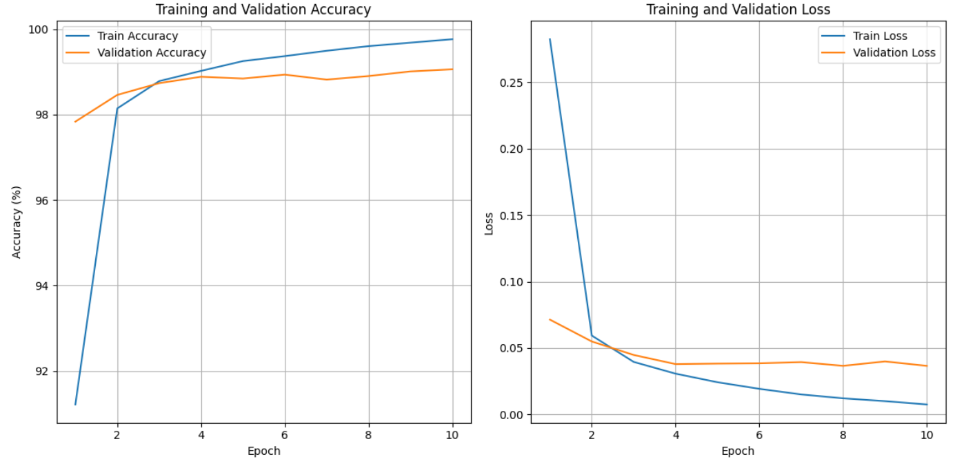
Simple CNN
Infosys Springboard

Slide 25
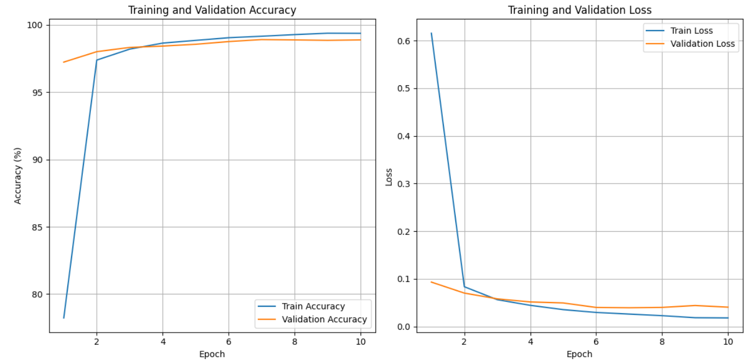
LeNet-5
Infosys Springboard

Slide 26

Model Evaluation
Process
Set model to evaluation mode
Iterate over test data in batches.
Perform forward pass to get outputs.
Compute accuracy by comparing predictions to ground truth.
Infosys Springboard

Slide 27
Model Evaluation Results
MLP Model
95.63%
Infosys Springboard

Slide 28
Model Evaluation Results
MLP Model
95.63%
Simple CNN Model
99.15%
Infosys Springboard

Slide 29
Model Evaluation Results
MLP Model
95.63%
Simple CNN Model
99.15%
LeNet-5 Model
98.85%
Infosys Springboard

Slide 30
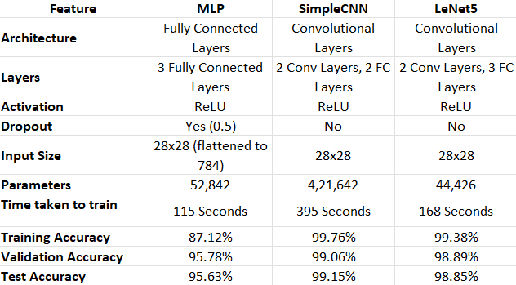
Model Comparison Table
Infosys Springboard

Slide 31
Analysis
MLP
Pros: Simpler, faster training.
Cons: Lower accuracy, not well-suited for image data.
CNN
Pros: Higher accuracy, good for image recognition.
Cons: More complex, longer training time.
LeNet-5
Pros: Designed for digit recognition, good balance of performance and complexity.
Cons: Older architecture, outperformed by modern CNNs in some cases.
Infosys Springboard

Slide 32





Snapshots of our User Interface
Infosys Springboard

Slide 33
Snapshots of our User Interface
Infosys Springboard

Slide 34
Snapshots of our User Interface
Infosys Springboard

Slide 35
Snapshots of our User Interface
Infosys Springboard

Slide 36
Snapshots of our User Interface
Infosys Springboard

Slide 37
Snapshots of our User Interface
Infosys Springboard

Slide 38
